Slide 1
Zero contact tachometer
Embedded C Project

Slide 2
Team members
Shri Harini A (21BEC1008)
Rakesh Ram M (21BEC1836)

Slide 3
What is
zero contact tachometer?

Slide 4
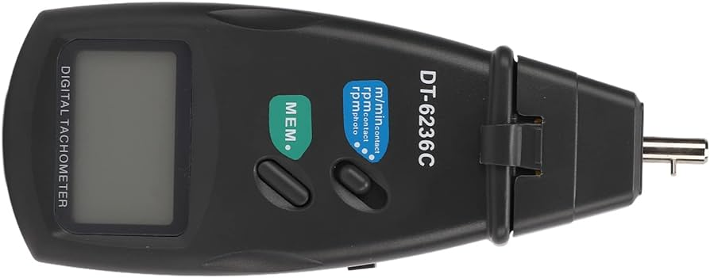
Zero contact tachometer - An Introduction
A tachometer is a device used to measure the angular speed of a rotating shaft or disk widely used in devices like fans, speedometer and motors.
The main advantage is the contactless measurement of speed; the angular speed can be measured from a distance depending on the range of the sensors used.

Slide 5
Components used

Slide 6
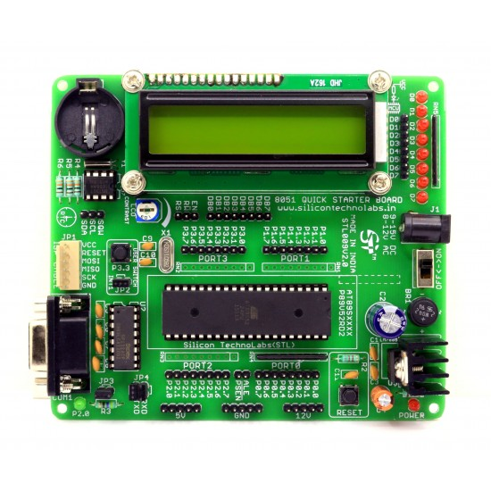
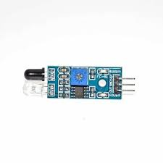
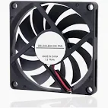
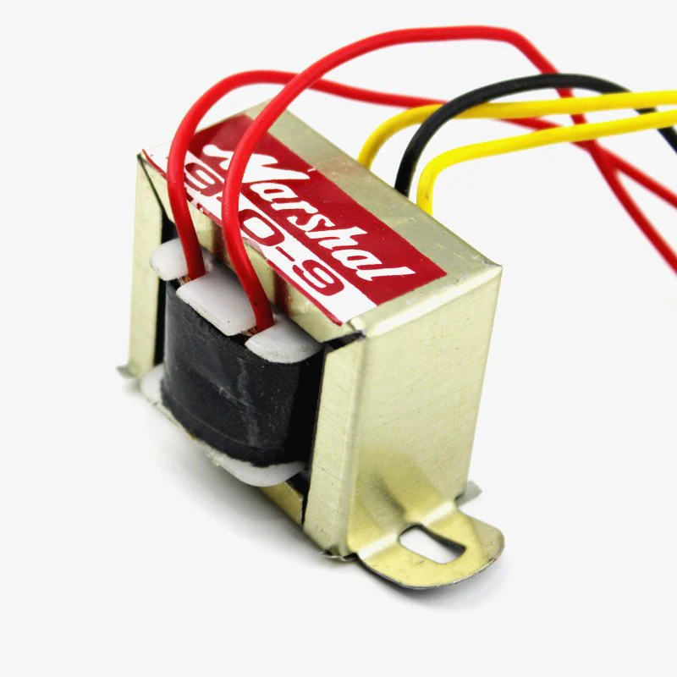
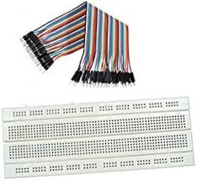
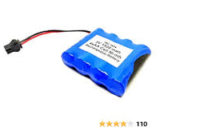
Components
8051 microcontroller
LCD display
IR sensor
GPIO cable
Resistor
Reflecting material - Al foil
Rotating device - fan
Step-down transformer
Breadboard
Connecting wires

Slide 7
Block diagram & Working

Slide 8
Block diagram
5V battery
8051
microcontroller
9-0-9
Transformer
IR sensor
Fan
LCD display

Slide 9
Working
IR sensor is connected to P2.4 of 8051 microcontroller interfaced with LCD.
A reflecting material is stuck on the rotating shaft on the fan and kept at a sufficient distance from the IR sensor but within the sensor’s range.
Connect step down 9-0-9 transformer to the fan. Add resistance between the fan and the transformer to regulate the speed of the fan.
Connect the 8051 microcontroller to the computer and dump the code in the same. Once debugged and run, the rpm is displayed on the LCD display

Slide 10
Code
#include<reg51.h>
#define lcd_data_pin P2
sbit rs = P3^7; //Register select (RS) pin
sbit rw = P3^6; //Read write (RW) pin
sbit en = P3^5; //Enable (EN) pin
sbit sensor=P2^4;
unsigned char c;
int num[10];
int rpmcount;
int rpmfunc(){
int i,j,rpm,count;
for(i=0;i<1000;i++){
for(j=0;j<1227;j++){
if(sensor){
count++;
while(sensor);
}
}
}
rpm=(count)*60;
return rpm;
}
void delay(int delay_time) // Time delay function
{
int j,k;
for(j=0;j<=delay_time;j++)
for(k=0;k<=1227;k++);
}
void lcd_cmd(unsigned char cmd_addr) // Funtion to send command on LCD
{
lcd_data_pin = cmd_addr;
en = 1;
rs = 0;
rw = 0;
delay(1000);
en = 0;
return;
}

Slide 11
Code
void lcd_data(unsigned int i) //Function to send data on LCD
{ int p;
int k=0;
while(i>0)
{
num[k]=i%10;
i=i/10;
k++;
}
k--;
for (p=k;p>=0;p--)
{
c=num[p]+48;
lcd_data_pin = c;
rw = 0;
rs = 1;
en = 1;
delay(1000);
en = 0;
}
return;
}
void lcd_ini() //Function to initialize LCD
{
lcd_cmd(0x01);
delay(1000);
lcd_cmd(0x38); // Configuring settings to 8-bit 2 row
delay(1000);
lcd_cmd(0x0E);
delay(1000);
lcd_cmd(0x06); //Display on
delay(1000);
lcd_cmd(0x81); //Set cursor to blink at line 1 positon 1
delay(1000);
}
void main()
{
lcd_ini();
rpmcount=rpmfunc();
lcd_data(rpmcount);
}

Slide 12
Future Scope & Conclusion

Slide 13
Future Scope
We can incorporate the data logging capabilities to record tachometer readings over time, enabling historical analysis and identification for maintenance of the obtained data
We can incorporate bluetooth or WI-FI connectivity for wireless data transmission, allowing users to monitor the readings obtained from the tachometer
Customize the tachometer’s features to meet the specific requirements of different industries

Slide 14
Conclusion
In conclusion, the development of a contactless tachometer using an 8051 microcontroller offers a versatile solution for accurately measuring rotational speeds without physical contact. The project not only provides a reliable tool for various industries but also opens avenues for various enhancements such as IOT Integration, wireless connectivity and advanced signal processing techniques.

